Slide 1
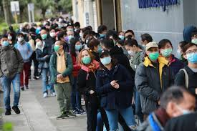
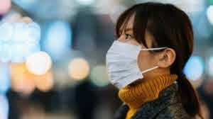
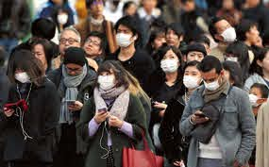
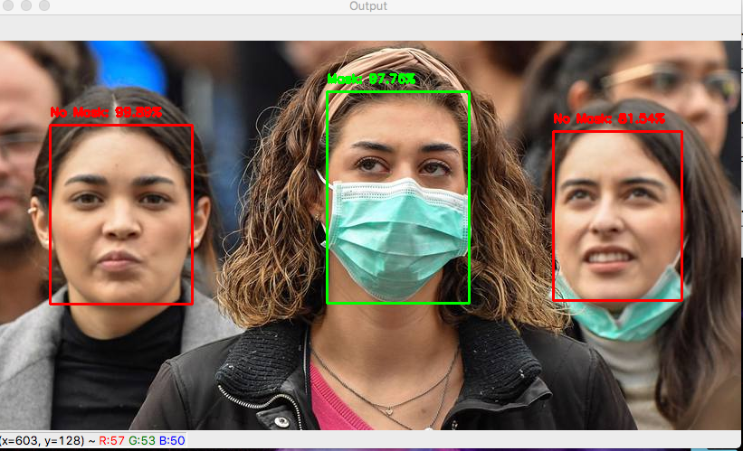
Intro
A Face Mask + Temperature Detection and Sanitization System Protecht
CreativiTeam:-
Rishon Fernandes, Sanath Shet and Nandan Bhandary.

Slide 2



Problem Statement
1. What is the Major Problem we are trying to address?
Covid-19 or the Corona virus
People not wearing masks
No-Sanitization issues
Temperature check
2. What is the Current Scenario Of this sector?
Community spread is going on
It is very risky to go out due to the spread
Search for a cure
Search for method to stop the spread
3. Which SDG does our problem come under?
Under SDG 3:- Health and Awareness

Slide 3
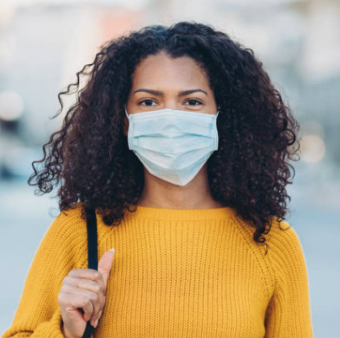


Our Solution
What is our Solution?
A Face Mask Detector, Temperature sensor and Sanitization System.
Video is streamed through esp32 cam
Face mask is detected through deep learning in python
Python sends the output back to the esp32
Esp32 gives a feedback to the user through DFplayer and OLED screen
99.95%
Temperature is measured through the wrist
Output is given accordingly
Hands are sanitized through the sanitizer

Slide 4


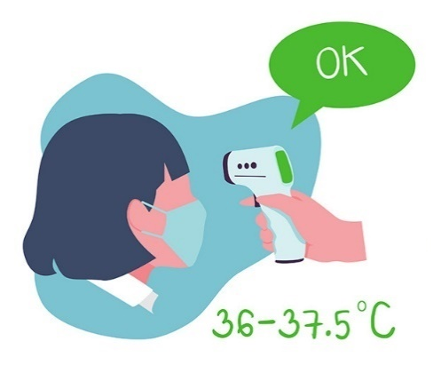
About Protecht
How does our solution help the world?
It ensures the 3 musts during these times:
Masks
Sanitizers
Temperature checking
Without these three things you cannot go anywhere without being caught!
It also reduces the spreading of the corona virus from 90% to 95%!
+
+

Slide 5
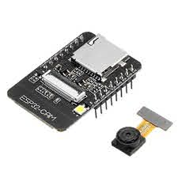
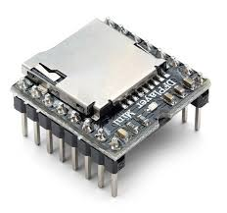
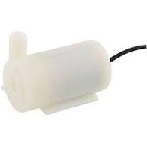

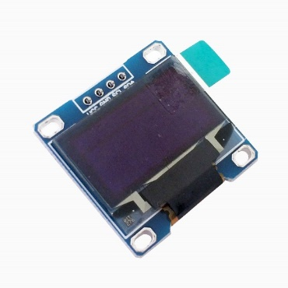
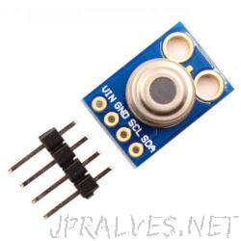
Our Tech
The Technologies used in our Project
ESP32 CAM
DFPlayer Mini
Submersible Pump
Used for Streaming Video
Mp3 Output based on stream
Used in Sanitizer dispenser
Python
0.96” OLED Screen
Contactless Temperature sensor
Used for Mask Detection
Used for graphical feedback
Measures Body Temperature

Slide 6
Our Team
Creativiteam Members
Rishon Fernandes
Took input from the ESP32 cam
Implemented the face mask detection algorithm and streamed the result to a webpage
Managed online collaboration
Managed the presentation
Coded in HTML, Python and CSS
Sanath Shet
Programmed the ESP32
Made the temperature sensing work by programming it and wiring it up
Coded in Arduino
OLED Screen graphical output
Nandan Bhandary
Hardware Management
OLED Screen graphical output
DFplayer mp3 Output
Designed the casing for temperature sensor and ESP32 cam (PCB)

Slide 7




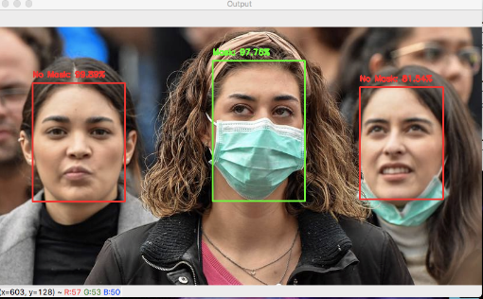
Market Reach
Market Reach
1. Is the market large enough to have people facing this problem / to pay for this solution?
2. Who else can use your solution other than the ones facing the problem?
Our product cost: Rs1500 +/-
Applicable in markets: Yes, since every market place has a PC
People facing this problem: Everyone
Affordable: Totally
Applicable for any business/public place/Home during the pandemic
After the corona virus subdues, people can use this system as a surveillance camera, theft detector… etc.

Slide 8

Thank You
SSTH means a lot to us!!!
A Face Mask + Temperature Detection and Sanitization System Protecht

